Slide 1
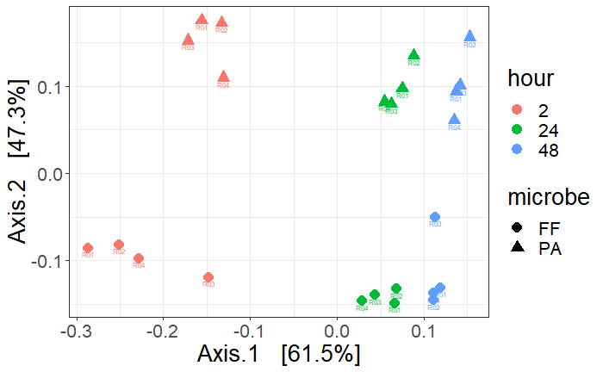

Slide 2
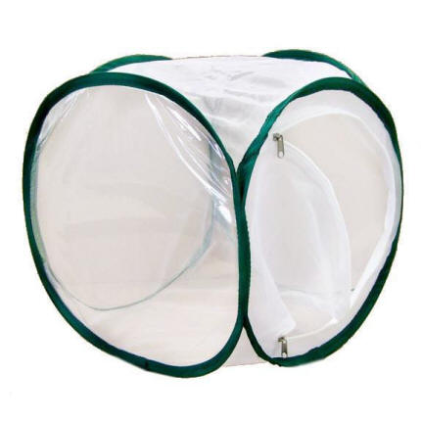
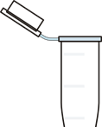
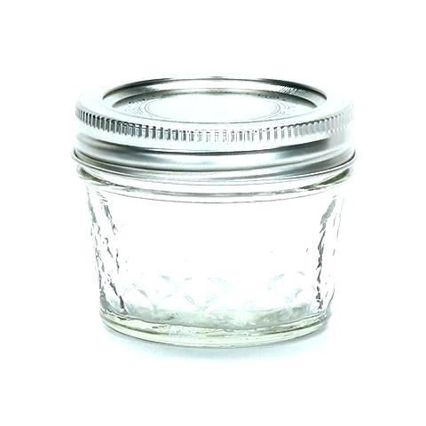
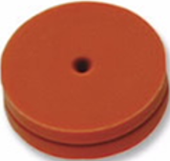
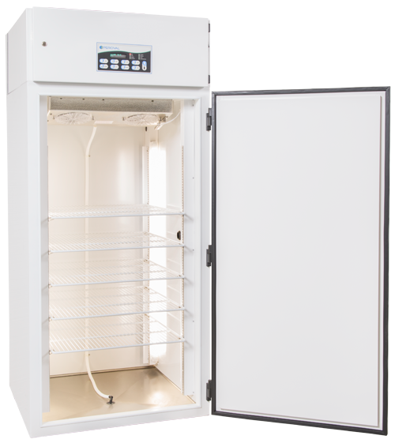
Equipment
Mesh Cages
Trap Jars
4 oz ball jar
Metal lid ring
Teflon lid cover with 2 holes
1 septa covered hole
1 hole plugged with a centrifuge tube
Incubators
25 C, 60% rH, and 16:8 L:D

Slide 3
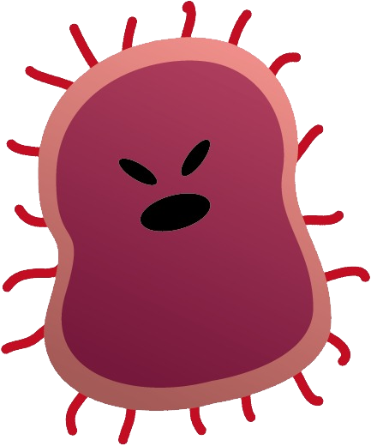
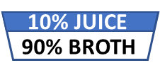
What is in a name?
Blank
Control
Treatment
1 mesh cage
2 empty trap jars
1 mesh cage
2 trap jars
10% juice
90% culture broth
1 mesh cage
2 trap jars
10% juice
90% culture broth
Microbes
10% JUICE
90% BROTH
10% JUICE
90% BROTH

Slide 4
F. faeni VOCs
P. agglomerans VOCs
Timolol
Carbonic acid, dimethyl ester
1-Butanol
1-Butanol, 3-methyl-
2-Nonanone
Benzene, 1,3-bis(1,1-dimethylethyl)-
Pyrazine, 3-ethyl-2,5-dimethyl-
Bicyclo[2.2.1]heptan-2-ol, 1,7,7-trimethyl-, (1S-endo)-
1-Propanol, 3-(methylthio)-
(-)-Myrtenol
Benzyl alcohol
Phenylethyl Alcohol
3-Cyclohexene-1-ethanol, .beta.,4-dimethyl-
3-Cyclohexene-1-ethanol, .beta.,4-dimethyl-
p-Mentha-1(7),8(10)-dien-9-ol
Eugenol
Disulfide, dimethyl
1-Butanol, 3-methyl-, acetate
1-Butanol
Heptanal
1-Butanol, 3-methyl-
2-Hexenal, (E)-
Acetoin
1-Heptanol
Furfural
1-Hexanol, 2-ethyl-
Benzonitrile
2-Furanmethanol
Mequinol
Benzyl alcohol
Phenylethyl Alcohol
2H-Pyran-2-carboxaldehyde, 5,6-dihydro-
Phenol

